Slide 1
Midterm presentation
Group members:
Dong Zhanqian, Zhou Xuanxuan, Zhang Zhengdao,
Liu Shiqing, Teng Kimhan, Borey Cheng

Slide 2
content
Requirement implement
For online customer
For manager
Database design
diagram
Schedule and labor divide

Slide 3
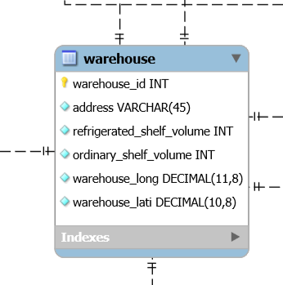
Requirement implement
surf the goods page and consult the discount goods

Slide 4
Requirement implement
add goods into the virtual track

Slide 5
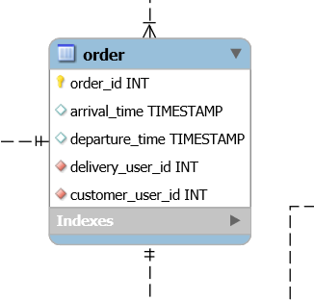
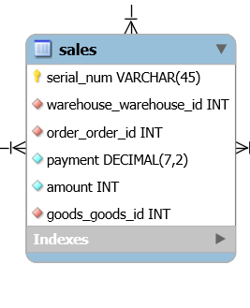
Requirement implement
make an order of the goods

Slide 6
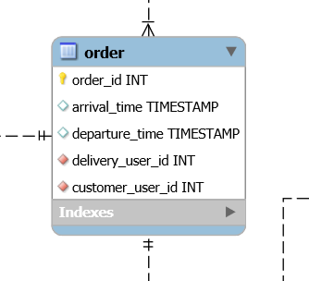
Requirement implement
check the delivery condition

Slide 7
Requirement implement

